Slide 1
Ch.2 Parameter Extraction in
Time-Domain Spectrometers
Lee Jong Geon

Slide 2
Contents
Material Properites and Wave Propagation
Extracting Optical Parameters fromTerahertz Time-Domain Spectromerters Data
Preprocessing and Postprocessing of Data
Sample Requirements

Slide 3
Material Properties and
Wave Propagation

Slide 4



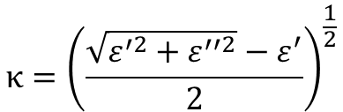
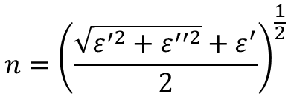

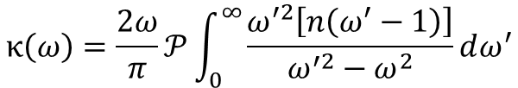
1.1 Complex Refeactive Index and Complex Permitivity
Complex Refractive Index
$$n={\left(\frac{\sqrt{ε^{′2}+ε^{′′2}}+ε^{′}}{2}\right)}^{\frac{1}{2}}$$
$$\overline{n}=n^{′} −jκ$$
$$\overline{ε}= {\overline{n}}^{2}$$
Complex Permittivity Index
$$κ={\left(\frac{\sqrt{ε^{′2}+ε^{′′2}}−ε^{′}}{2}\right)}^{\frac{1}{2}}$$
$$\overline{ε}=ε^{′} −jε^{′′}$$
Kramers-Kronig relations
$$n\left(ω\right)=1+\frac{2ω}{π}𝒫\int_{0}^{∞}{\frac{κ\left(ω^{′}\right)}{ω^{′2}−ω^{2}}dω^{′}}$$
$$κ\left(ω\right)=\frac{2ω}{π}𝒫\int_{0}^{∞}{\frac{ω^{′2}\left[n\left(ω^{′}−1\right)\right]}{ω^{′2}−ω^{2}}dω^{′}}$$

Slide 5
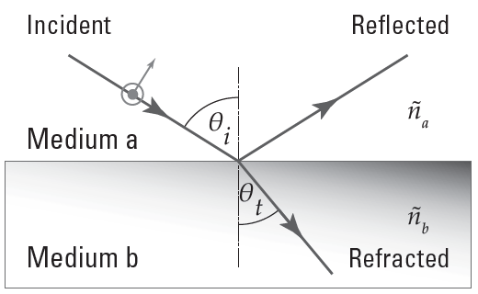






1.2 Plane Wave Propagation Across an Interface – Fresnel Equations
$$t_{TE}=\frac{2{\overline{n}}_{a}\cos{θ_{i}}}{{\overline{n}}_{a}\cos{θ_{i}}+{\overline{n}}_{b}\cos{θ_{t}}}$$
$$t_{TM}=\frac{2{\overline{n}}_{a}\cos{θ_{i}}}{{\overline{n}}_{a}\cos{θ_{t}}+{\overline{n}}_{b}\cos{θ_{i}}}$$
$$r_{TE}=\frac{{\overline{n}}_{a}\cos{θ_{i}} −{\overline{n}}_{b}\cos{θ_{t}}}{{\overline{n}}_{a}\cos{θ_{i}}+{\overline{n}}_{b}\cos{θ_{t}}}$$
$$r_{TM}=\frac{{\overline{n}}_{a}\cos{θ_{t}} −{\overline{n}}_{b}\cos{θ_{i}}}{{\overline{n}}_{a}\cos{θ_{t}}+{\overline{n}}_{b}\cos{θ_{i}}}$$
$$r_{b→a}=−r_{a→b}$$
$$t_{a→b}t_{b→a}=1−r_{a→b}^{2}$$

Slide 6
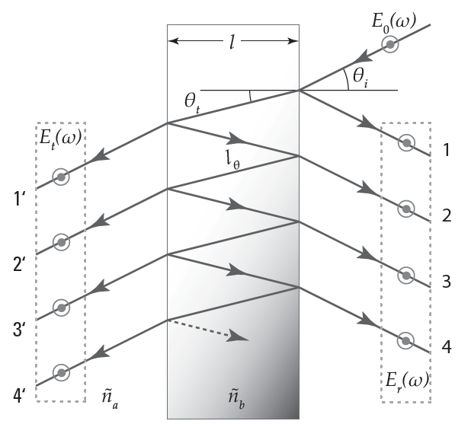
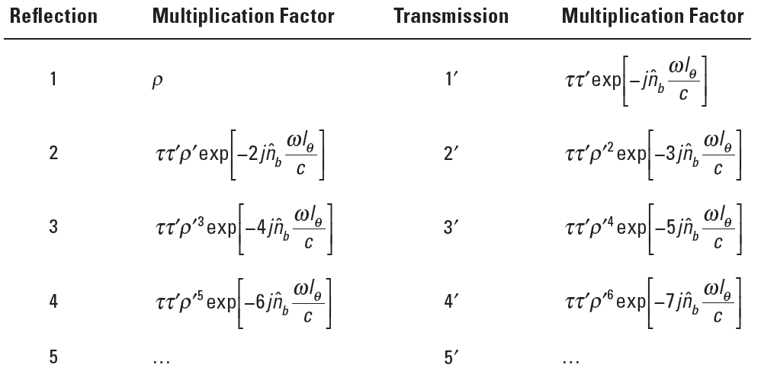
1.3 Plane Wave Propagation Through a Dielectric Slab

Slide 7
1.3 Plane Wave Propagation Through a Dielectric Slab

Slide 8
1.4 Fabry-Pérot Effect

Slide 9
Extracting Optical Parameters from
Terahertz TDS Data

Slide 10
2.1 Transmission-mode Terahertz Time-Domain Spectrometers: Approximation

Slide 11
References
Clough, B., J. Dai, and X. –C. Zhang, “

